Slide 1
WELCOME
Exit Strategies
Robert Snook & Steve Field

Slide 2
WELCOME
Robert Snook

Slide 3
Industry Benchmark
Increasing business value
+7
Scale and Scalability
+6
Brand and USP’s
+5
Channels and Extensions
+4
Product and Innovation
+3
Systems and Repeatability
+2
Culture and Capability
-2
Excessive High or Fixed Costs
-3
Revenue Risk
-4
Assets and Condition
-5
Liabilities
-6
Dependence on Management
-7
Uncontrollable External Factors
Decreasing business value
ABP Convention 2016 Preparing your business for sale

Slide 4
WELCOME
Steve Field

Slide 5
My Bodyshop
What’s the value

Slide 6
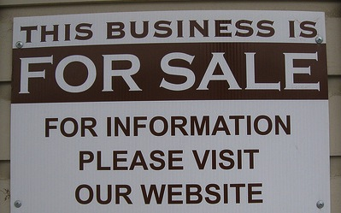

Slide 7
Most important fact first

Slide 8
Don’t be an emotional seller
Moving
Expressive
Emotive
Sensitive

Slide 9
Know what you are selling
The business
The property
The assets
The Shares
The Debtor book

Slide 10
Know your reasons for selling
Full exit
Life style
Down sizing
Direction change
Sale to grow

Slide 11
Know the tools of Calculation
EBITDA and EBIT
Reconstructed accounts
Revenue and Customer base
Change control clauses
CSI and factual reports

Slide 12
Know the value silos
Property
Fixed assets
Stock
Staff
Contracts

Slide 13
Property

Slide 14
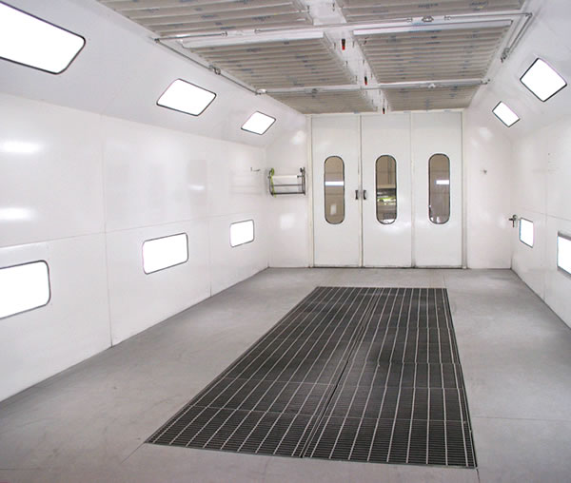
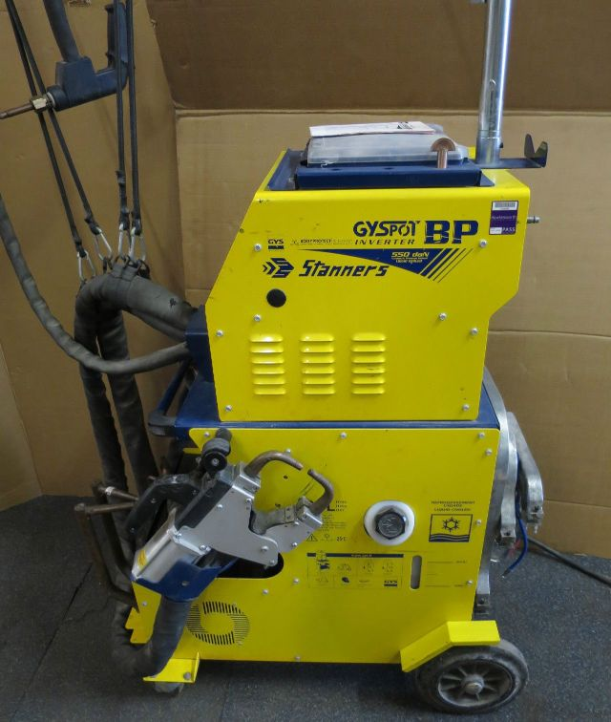
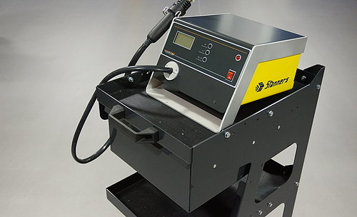

Slide 15
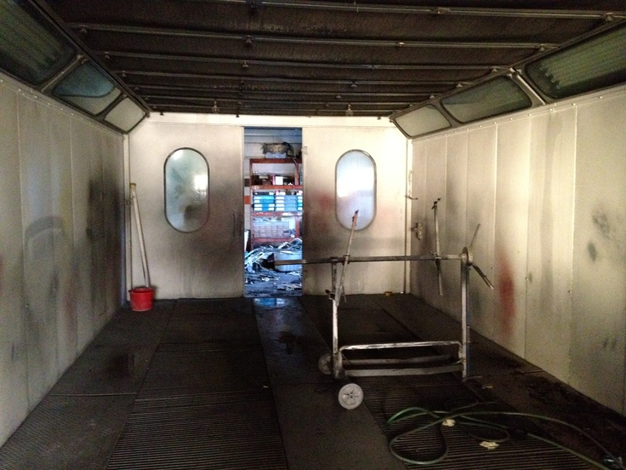
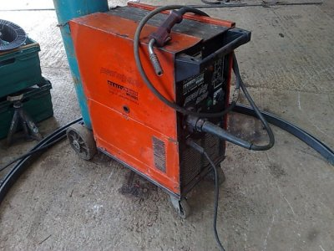
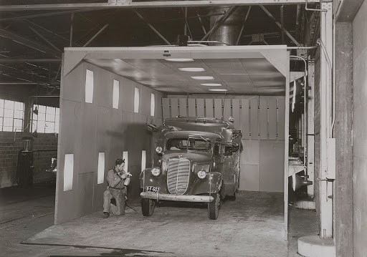
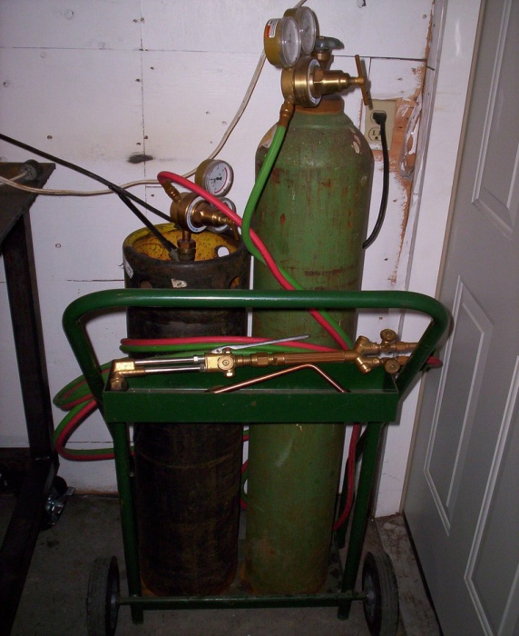

Slide 16
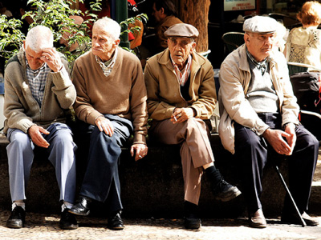
Paint shop and Panel team

Slide 17
Seller V Buyer
Vendor
Retailer
Supplier
Peddler
Purchaser
Consumer
Customer
Bargain Hunter
V

Slide 18
A Final note
In general, buyers only buy when desire and perception of value are both balanced. So what is it worth? Only what a buyer is prepared to pay.

Slide 19
Thank you

Slide 20
THANK YOU
Robert Snook
Steve Field

